Slide 1
Fundamental Equilibrium concepts
(O.S. 13 Gilbert 14)

Slide 2
Examining How/Why Reactions Happen
Thermodynamics
Is ∆S_{univ} (or ∆G) favorable?
Kinetics
At what rate is the reaction going to occur?
Chemical Equilibrium
How much product is going to form?

Slide 3
Equilibrium
Chemical Equilibrium:
A dynamic process in which concentrations of reactants and products remain constant over time
Rate of a reaction in the forward direction matches the rate in the reverse direction
Reactants ⇌ Products
Notes:
Rate of forward reaction = rate of backward reaction

Slide 4
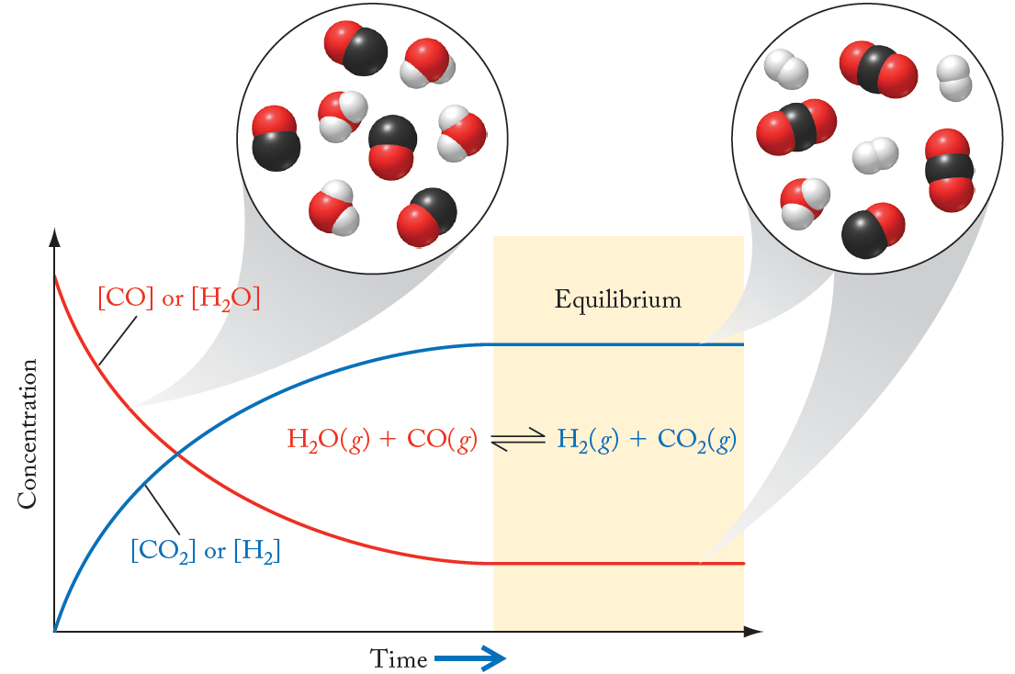

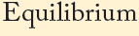
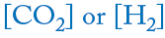
Equilibrium
H₂O(g) + CO(g) ⇌ H₂(g) + CO₂(g)
At equilibrium the concentration of products and reactions is constant, but not necessarily equal.

Slide 5
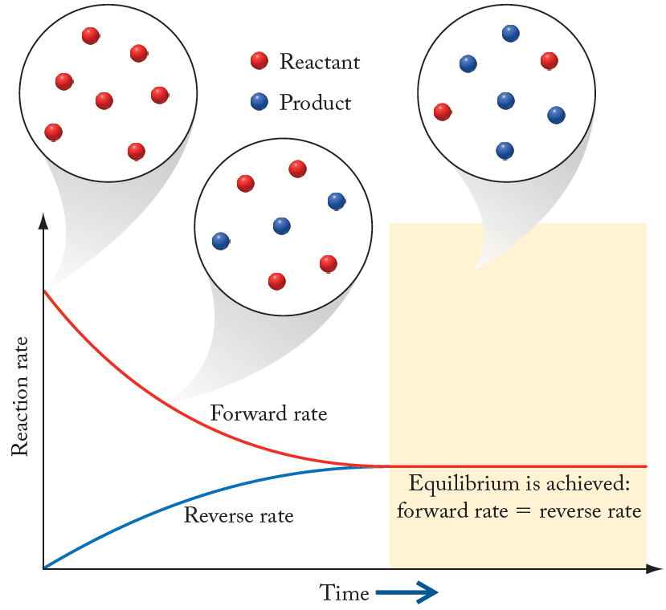
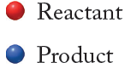
Equilibrium
At equilibrium the rates of product formation and reactant consumption are constant and equal.

Slide 6
Equilibrium
N₂O₄(g) ⇌ 2NO₂(g)
Experimentally determined
Definition of equilibrium
equilibrium expression
generalized equilibrium constant definition
Notes:
k (lowercase) is impacted by temp, however K (capital) is a constant and is not

Slide 7
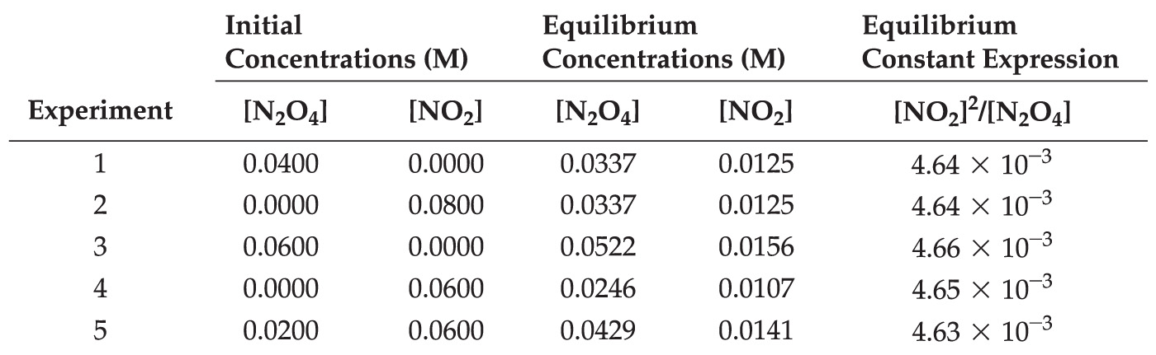
Equilibrium Constant (K_{c})
2NO₂(g) ⇌ N₂O₄(g)
Constant!
equilibrium expression
Can we take a generalized approach to writing equilibrium expressions without dealing with rate constants?
Notes:
When pressure decreases, equilibrium moves in the direction with more moles of gas (in this case NO2)
opposite is also true

Slide 8
Equilibrium Constant (K_{c})
Generalized Reversible Reaction:
aA + bB ⇌ cC + dD
Equilibrium Expression:
Products
Equilibrium constant is ALWAYS unitless regardless of number of moles of products/reactants
Reactants
Law of Mass Action:
The ratio of concentrations/partial pressures of products to reactants at equilibrium has a characteristic value at a given temperature
Notes:
Exponents are the coefficients

Slide 9
Example: Equilibrium Expressions
Write an expression for the equilibrium constant in terms of partial pressures for the decomposition of one mole of ammonia gas (NH₃) forming nitrogen and hydrogen in their standard states.
NH₃(g) ⇌ 1/2N₂(g) + 3/2H₂(g)
Equilibrium concepts also apply to partial pressures of gases.
Notes:
If everything was doubled in the equation, all the exponents would become whole numbers and the Kp would have to be squared for it to still be true (see next slide)

Slide 10
Example: Equilibrium Expressions
Write an expression for the equilibrium constant in terms of partial pressures for the decomposition of one mole of ammonia gas (NH₃) forming nitrogen and hydrogen in their standard states.
2NH₃(g) ⇌ 1N₂(g) + 3H₂(g)
Equilibrium concepts also apply to partial pressures of gases.

Slide 11
Law of Mass Action
Generalized Reversible Reaction:
aA + bB ⇌ cC + dD
where [X] = concentration units of mol/L (M)
where P_{X} = units of partial pressure (atm)
Notes:
Make sure you are using the correct units
Also remember products over reactants

Slide 12
Value of K
Value of K indicates extent of reaction:
2H₂(g) + O₂(g) ⇌ 2H₂O(g) K = 3×10⁸¹
Very large K: favors formation of products
2CO₂(g) ⇌ 2CO(g) + O₂(g) K = 3×10⁻⁹²
Very small K: favors reactants; not much product formed at equilibrium
H₂O(g) + CO(g) ⇌ H₂(g) + CO₂(g) K = 24
Intermediate value of K: Comparable amounts of products and reactants at equilibrium

Slide 13
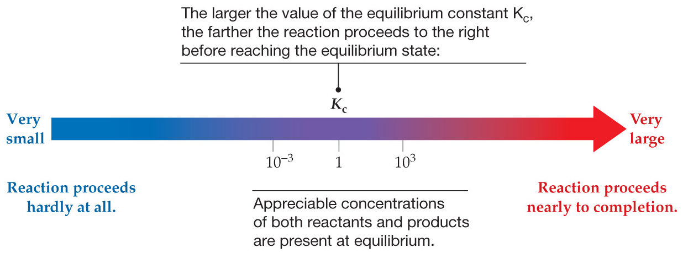
Judging Extent of a Reaction
Notes:
Remember bigger Kc means reaction happens more, and smaller Kc means reaction happens less

Slide 14
Example: Using K_{c}
At 500 K, the equilibrium constant for the dissociation reaction, H₂(g) ⇌ 2H(g), is very small (K_{c} = 1.2 ×10⁻⁴²).
What is the molar concentration of H atoms at equilibrium if the equilibrium concentration of H₂ is 0.1 M?
Equilibrium Expression:
Solve for [H]:

Slide 15
Relating Gas Equilibrium to Concentration Equilibrium
aA + bB ⇌ cC + dD
partial pressure equilibrium expression
Assume A, B, C, and D are all in the gas phase
How do P_{A}, P_{B}, P_{C}, P_{D} relate to concentrations?
ideal gas law
For reactant C:
Notice!
Can do the same thing for rest of species

Slide 16
Relating Gas Equilibrium to Concentration Equilibrium
aA + bB ⇌ cC + dD
Substitute into equilibrium expression:
Rearrange.
Notice!
Substitute & Rearrange.
Just a mathematical way of saying “change in # gas phase moles (n), final - initial”
Where, R = ideal gas constant (0.0821 L·atm/mol·K); T = temperature (K); ∆n = change in number of gas phase moles
Notes:
Focus mostly on the last equation, the rest is just how to get that equation

Slide 17
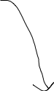
Example: Calculating K_{p} from K_{c}
Calculate K_{p} for:
PCl₅(g) ⇌ PCl₃(g) + Cl₂(g)
Given, K_{c} = 4.00 at 425°C
Relationship between K_{p} and K_{c}
Note: because we are using molarity as our standard concentration form, R needs to have units in (L·atm)/(mol·K).
Always unitless
Notes:
The coefficients are all 1

Slide 18
Practice: Expressions for K
Write the equilibrium constant expressions (K_{c} and K_{p}) for the synthesis of NO₂.
4NH₃(g) + 7O₂(g) ⇌ 4NO₂(g) + 6H₂O(g)
Generic equilibrium expression
Products
Reactants
a, b, c, d are corresponding coefficients from chemical equation
Relationship between K_{p} and K_{c}

Slide 19
K for Reverse Reaction
Forward Reaction:
2NO₂(g) ⇌ N₂O₄(g)
Reverse Reaction:
N₂O₄(g) ⇌ 2NO₂(g)

Slide 20
Effect of Changing Chemical Coefficients
Given:
2NO(g) + O₂(g) ⇌ 2NO₂(g)
Can write an equilibrium expression:
What happens to the equilibrium expression if we start with one mole of NO instead of two?
NO(g) + ½O₂(g) ⇌ NO₂(g)
New equilibrium expression:
If you multiple an equation by a number n, then the change in K:
Relationship between
K₁ & K₂

Slide 21
Combining K values
More Hess’s Law-style chemical equation arithmetic.
In adding chemical equations:
Equilibrium constants for each equation are multiplied together (not added)
Any equation that needs to be reversed; the reciprocal of the equilibrium is taken.
Any equation that needs to have coefficients adjusted through multiplication; the equilibrium constant is raised to the power of that multiplier.
Notes:
When adding reactions, intermediates that need to be canceled out need to be on opposite sides
_{e.g.}
_{A+B->C}
_{+C->D+E}
_{A+B->D+E}

Slide 22
Combining K values
In adding chemical equations:
Equilibrium constants for each equation are multiplied together (not added)
Any equation that needs to be reversed; the reciprocal of the equilibrium is taken.
Any equation that needs to have coefficients adjusted through multiplication; the equilibrium constant is raised to the power of that multiplier.
Note: if you can’t remember these rules, you can always derive the answer by writing the sum of the reaction, or reverse as shown in the previous slides.

Slide 23
Practice: Combining K values
Given: N₂O₄(g) ⇌ 2NO₂(g)
a) Determine the K_{c} for the reaction:
2NO₂(g) ⇌ N₂O₄(g)
Determine the K_{c} for the reaction:
NO₂(g) ⇌ ½ N₂O₄(g)
a)
b)
Notice! The reaction is merely reversed.
Notice! The reaction from a) has been multiplied by ½.
from a)
for b)

Slide 24
Reaction Quotient (Q)
Mass Action Expression:
Equivalent to equilibrium constant expression, but applied to reaction mixtures that may or may not be at equilibrium
Reaction Quotient (Q):
Numerical value of the mass action expression for any values of concentrations (or partial pressures) of the reactants and products
At equilibrium: Q = K
Value of Q indicates how reaction is proceeding (if at equilibrium, or not)

Slide 25
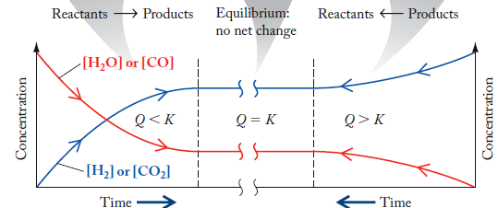
Comparing Q with K
H₂O(g) + CO(g) ⇌ H₂(g) + CO₂(g)
Q < K
reaction proceeds toward products
Q = K
reaction at equilibrium
Q > K
reaction proceeds toward reactants
Notes:
Smaller q = forward reaction
Equal q = equilibrium
Larger q = backward reaction
think products over reactants, if reactants is too big q would be smaller (forward reaction), if products is too big q would be bigger (backward reaction)

Slide 26
Example: Comparing Q and K
Is the following reaction at equilibrium at the stated conditions? If not at equilibrium, determine which direction the reaction will proceed. (K_{c} = 5.6)
CH₄ + H₂O ⇌ CO + 3H₂
0.100 M 0.200 M 0.500 M 0.800 M
If at equilibrium,
Determine Q_{c},
the reaction will proceed toward the left reducing Q_{c}
Notes:
Make sure Kc is in M, if not then it has to be changed to M

Slide 27
Types of Equilibria
Homogeneous Equilibria: Involve reactants and products in the same phase
H₂O(g) + CO(g) ⇌ H₂(g) + CO₂(g)
Heterogeneous Equilibria: Involve reactants and products in more than one phase
CaCO₃(s) ⇌ CaO(s) + CO₂(g)
Concentration of pure solid is constant.
Concentration of pure liquid is constant.

Slide 28
Heterogeneous Equilibria
CaCO₃(s) ⇌ CaO(s) + CO₂(g)
From the Law of Mass Action can write an equilibrium expression
However, concentrations of both solids/liquids are essentially constant with respect to temperature
Can substitute into original expression
The equilibrium only depends on the concentration of CO₂
Notes:
Because the solids don’t change, their concentration is constant and can be expressed as a constant

Slide 29
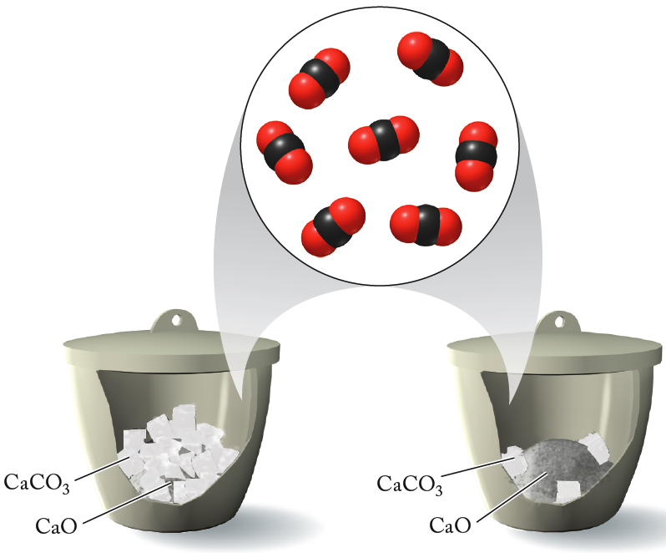
Heterogeneous Equilibria
CaCO₃(s) ⇌ CaO(s) + CO₂(g)
Note: Amount of solid (or liquid) product/reactant does not affect the equilibrium

Slide 30
Le Châtelier’s Principle
Le Châtelier's Principle: “A system at equilibrium responds to a stress in such a way that it relieves that stress.”
Factors that will change the relative rates of forward/reverse reactions, or change the value of Q compared to K, will cause a shift in the position of equilibrium.
Notes:
Basically: the reaction will always go towards K (equilibrium)

Slide 31
Concentration Stress
H₂O(g) + CO(g) ⇌ H₂(g) + CO₂(g)
From the Law of Mass Action can write an equilibrium expression
Hypothetically, what would happen if we removed some amount of CO₂(g)?
Rate of reverse reaction decreases due to lower concentration of CO₂
Reaction proceeds in forward direction to re-establish equilibrium
We have decreased the numerator, thus making Q smaller than K. This will drive the reaction towards products

Slide 32
Effects of Temperature
2N₂(g) + 3H₂(g) ⇌ 2NH₃(g)
ΔH_{rxn} < 0
Hypothetically, what would happen if we raised the temperature of the system?
Approach:
Treat heat as reactant or product
Increasing temperature adds heat to the product side of equation; reaction shifts left
∆H_{rxn} is less than zero, the reaction is exothermic, energy is given off
2N₂(g) + 3H₂(g) ⇌ 2NH₃(g) + energy
Using this approach, changing temperature is directly synonymous with changing concentration of a chemical species (energy).
Notes:
Increasing heat = adding energy
To figure out how it will change, figure out ∆Hrxn to see if it is exothermic or endothermic (where energy is)

Slide 33
Consider the equilibrium: CH₄(g) + H₂O(g) + 206 kJ ⇌ CO(g) + 3 H₂(g)
Le Châtelier’s Principle
Concentration:
Increase concentration of a species, the reaction will proceed away from that species
Decrease concentration of a species, the reaction will proceed toward that species
Temperature:
Energy is synonymous with chemical species
Increase temperature of reaction, the reaction will proceed away from the energy term.
Decrease temperature of reaction, the reaction will proceed toward the energy term.
Notes:
Concentration:
increasing concentration on one side causes it to go in the other direction
decreasing concentration on one side causes the reaction to go in its direction
Temperature:
increasing temperature will cause it to go away from the side with the energy term
decreasing temperature will cause it to go towards the side with the energy term

Slide 34
Effects of Pressure/Volume
2NO₂(g) ⇌ N₂O₄(g)
From the Law of Mass Action can write an equilibrium expression
Hypothetically, what would happen if we changed the volume of the system?
Can write a reaction quotient expression, doubling the pressure for each species
From the application of the ideal gas law
If we halve the volume:
Then, substituting:
Q < K, reaction shifts right toward products
Notes:
Pressure was doubled, reaction moves forward

Slide 35
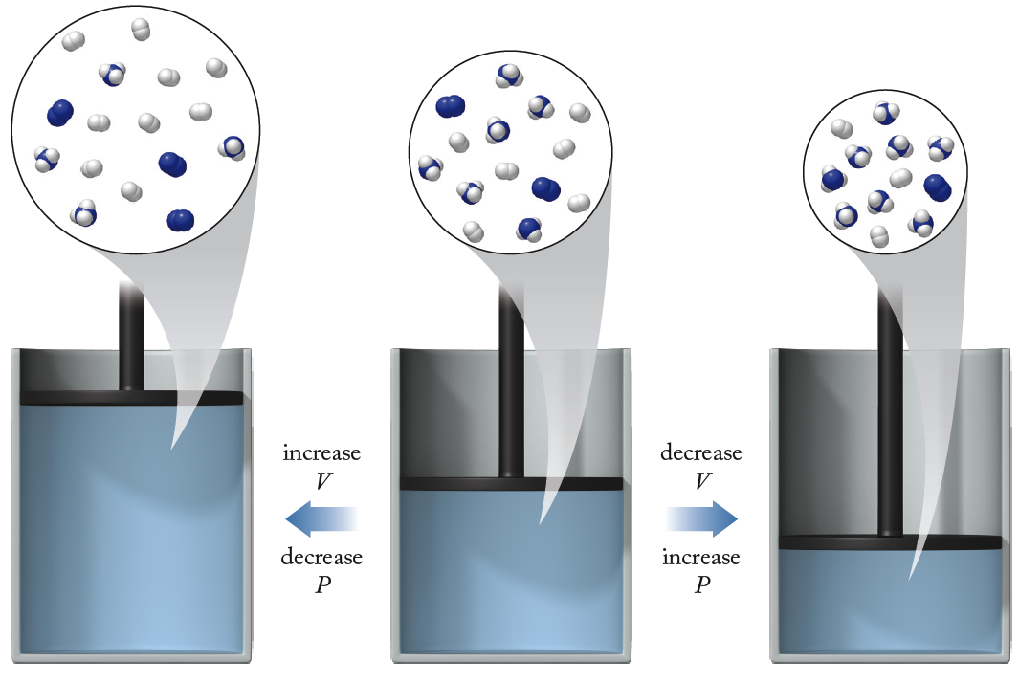
Effects of Pressure/Volume
2N₂(g) + 3H₂(g) ⇌ 2NH₃(g)
Important to remember pressure and volume
are inextricably tied-together

Slide 36
Consider the equilibrium: CH₄(g) + H₂O(g) + 206 kJ ⇌ CO(g) + 3 H₂(g)
Le Châtelier’s Principle
Pressure
Increase pressure of a species, the reaction will proceed away from that species.
Decrease pressure of a species, the reaction will proceed toward that species.
Increase pressure of reaction vessel by changing volume, the reaction will proceed away from side that has most moles of gas.
Decrease pressure of reaction vessel by changing volume, the reaction will proceed toward the side that has most moles of gas.

Slide 37
Consider the equilibrium: CH₄(g) + H₂O(g) + 206 kJ ⇌ CO(g) + 3 H₂(g)
Le Châtelier’s Principle
Volume
Related inversely to pressure
Increase volume of reaction vessel, the reaction will proceed toward the side that has most moles of gas.
Decrease volume of reaction vessel, the reaction will proceed away from the side that has most moles of gas.

Slide 38
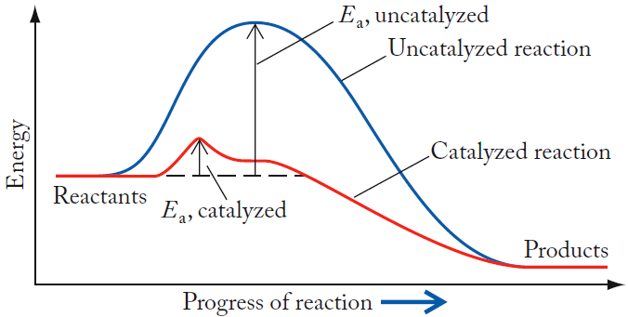
Catalysts and Equilibrium Systems
Systems reach equilibrium faster.
No change in K or position of equilibrium.
Notes:
Catalyzing something only speeds up the rate the reaction moves towards equilibrium

Slide 39
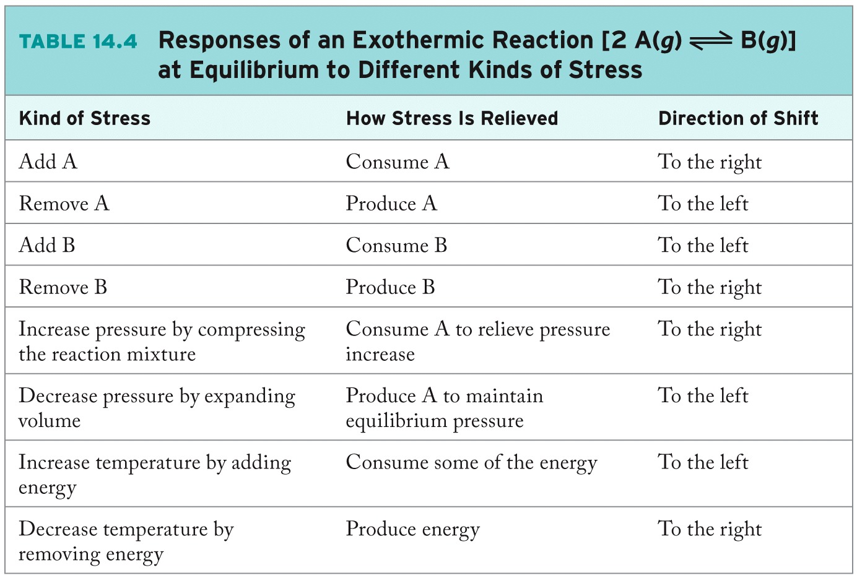
Le Châtelier’s Principle: Generalized

Slide 40
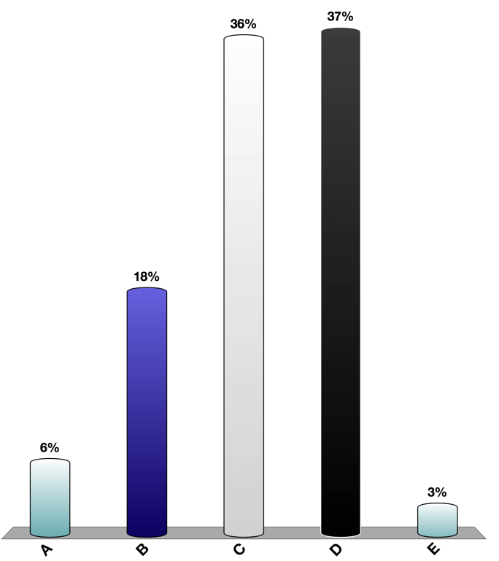
Discussion: Equilibrium
Consider the reaction:
aA(g) + bB(g) ⇌ cC(g) + dD(g)
A friend asks the following:
“I know we have been told that if a mixture of A, B, C, and D is at equilibrium and more of A is added, more C and D will form. But how can more C and D form if we do not add more B?
What do you tell your friend?
Notes:
skipped

Slide 41
Calculations Based on K
Determine whether a reaction has reached equilibrium (Q vs. K).
Knowing the value of K and the starting concentrations or partial pressures, one can calculate their equilibrium concentrations, etc.
RICE (or ICE) Table:
R: Balanced chemical equation
I: Initial concentrations (or pressures)
C: Changes as system moves to equilibrium
E: Equilibrium concentrations (or pressures)

Slide 42
Practice: Calculations Based on K
The equilibrium constant K_{c} for the reaction of H₂ with I₂ is 57.0 at 700 K:
H₂(g) + I₂(g) ⇌ 2HI(g) K_{c} = 57.0 at 700 K
If 1.00 mol of H₂ is allowed to react with 1.00 mol of I₂ in a 10.0 L reaction vessel at 700 K, what are the concentrations of H₂, I₂, and HI at equilibrium? What is the composition of the equilibrium mixture in moles?
Given initial conditions,
need to calculate equilibrium conditions

Slide 43
Practice: Calculations Based on K
Step 1: Write the balanced equation for the reaction. Compute Q_{c} and compare to K_{c} to determine the direction of reaction.
H₂(g) + I₂(g) ⇌ 2HI(g)
K_{c} = 57.0
Q_{c} < K_{c} so the reaction proceeds to the right

Slide 44
Practice: Calculations Based on K
Step 2: Make a table relating the change from initial to equilibrium concentrations for each species.
H₂(g) + I₂(g) ⇌ 2HI(g)
 | [H₂] | [I₂] | [HI]
Initial Concentration (M)
Change in Concentration (M)
Equilibrium Concentration (M)
0.100
0.100
0
-x
-x
+2x
0.100 - x
0.100 - x
+2x
Define x as concentration in mol/L of one of the substances that reacts in going to equilibrium. Use stoichiometry to relate the rest in terms of x

Slide 45
Practice: Calculations Based on K
 | [H₂] | [I₂] | [HI]
Initial Concentration (M) | 0.100 | 0.100 | 0
Change in Concentration (M) | -x | -x | +2x
Equilibrium Concentration (M) | 0.100 - x | 0.100 - x | +2x
Step 3: Substitute equilibrium concentrations into equilibrium expressions and solve for x.
Now this becomes a math problem!
Group terms:
Multiple through:
Get rid of fraction:
Notes:
If lucky enough to be able to take sqrt before multiply then have to do ± the sqrt.

Slide 46
Practice: Calculations Based on K
Often, use of the quadratic formula will be necessary. It will produce two possible answers, only one of which will make sense.
Equation of the form:
Quadratic Formula
Note the plus/minus sign…the quadratic formula will provide two potential solutions.
Both answers positive, however need to check plausibility.
Can’t have negative concentrations

Slide 47
Practice: Calculations Based on K
Step 4: Calculate the equilibrium concentrations from the determined value of x.
 | [H₂] | [I₂] | [HI]
Initial Concentration (M) | 0.100 | 0.100 | 0
Change in Concentration (M) | -x | -x | +2x
Equilibrium Concentration (M) | 0.100 - x | 0.100 - x | +2x
Step 5: Check results by substituting them into the equilibrium.

Slide 48
Practice: Calculations Based on K
The equilibrium constant K_{c} for the reaction of H₂ with I₂ is 57.0 at 700 K:
H₂(g) + I₂(g) ⇌ 2HI(g) K_{c} = 57.0 at 700 K
If 1.00 mol of H₂ is allowed to react with 1.00 mol of I₂ in a 10.0 L reaction vessel at 700 K, what are the concentrations of H₂, I₂, and HI at equilibrium? What is the composition of the equilibrium mixture in moles?

Slide 49
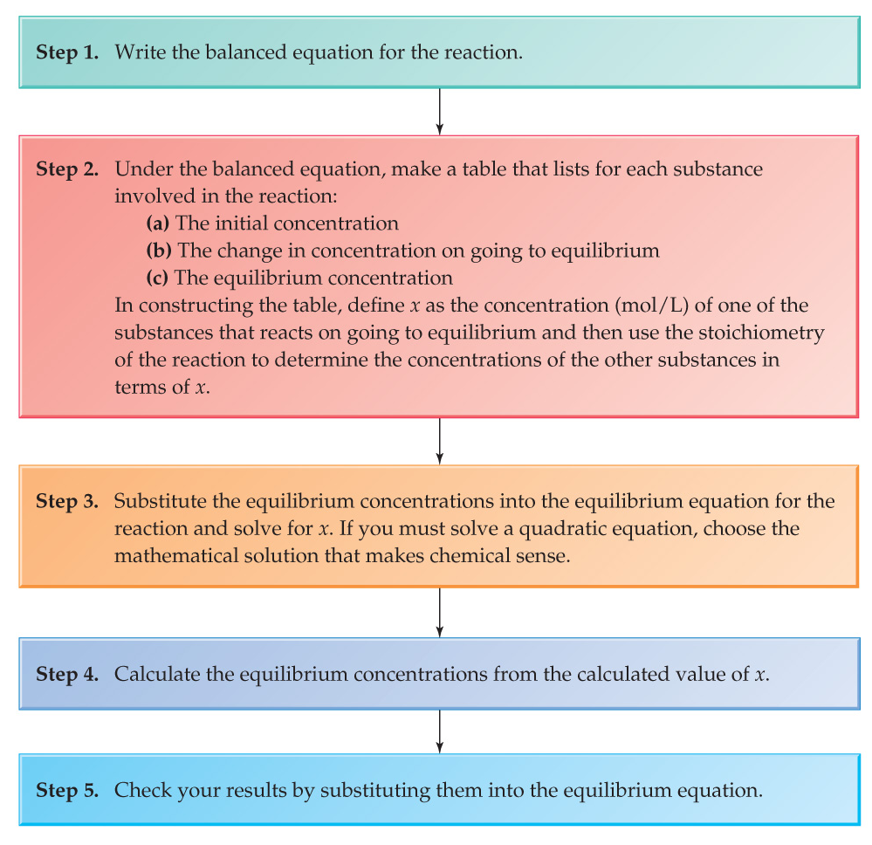
Using the Equilibrium Constant

Slide 50
For the reaction 2 H₂S(g) ⇌ 2 H₂(g) + S₂(g), K_{p} = 1.5×10⁻⁵ at 800.0°C. If the initial partial pressure of H₂ and S₂ in a closed container are 4.00 atm and 2.00 atm, respectively, what is the approximate equilibrium partial pressure of H₂S?
Practice: Calculations Based on K
Just set up the expression needed to solve, don’t worry about solving it.

Slide 51
For the reaction 2 H₂S(g) ⇌ 2 H₂(g) + S₂(g), K_{p} = 1.5×10⁻⁵ at 800.0°C. If the initial partial pressure of H₂ and S₂ in a closed container are 4.00 atm and 2.00 atm, respectively, what is the approximate equilibrium partial pressure of H₂S?
Practice: Calculations Based on K
2H₂S(g) ⇌ 2H₂(g) + S₂(g)
Initial Pressure (atm)
Change in Pressure (atm)
Equilibrium Pressure (atm)
0
4
2
+2x
-2x
-x
2x
4 - 2x
2 - x

Slide 52
Practice: Calculations Based on K
2H₂S(g) ⇌ 2H₂(g) + S₂(g)
Initial Pressure (atm)
Change in Pressure (atm)
Equilibrium Pressure (atm)
0
4
2
+2x
-2x
-x
2x
4 - 2x
2 - x
Using Wolfram Alpha, or something like that…

Slide 53
Equilibrium and Thermodynamics
Free energy change for a reaction:
An alternative expression can be derived:
The derivation of this is actually non-trivial. It will be approached in an advanced physical chemistry or thermodynamics class.
At equilibrium, ∆G_{rxn} = 0 and Q = K
Expression relating the free energy of a reaction at a particular temperature to its equilibrium constant.

Slide 54
Equilibrium and Thermodynamics
An alternative expression can be derived:
At equilibrium, ∆G_{rxn} = 0 and Q = K
PAY ATTENTION: ∆G_{rxn} is NOT the same as ∆G°_{rxn} ∆G “not”
∆G_{rxn} is ∆G under current condition and = 0 at Equilibrium
∆G°_{rxn} is under standard conditions (e.g. 1 atm or 1M)

Slide 55
Equilibrium and Thermodynamics
Units
K is K_{p} for gas phase reactions
atm
K is K_{c} for solution phase reactions
mol/L
For mixed gas/solution phase reactions
atm & mol/L

Slide 56
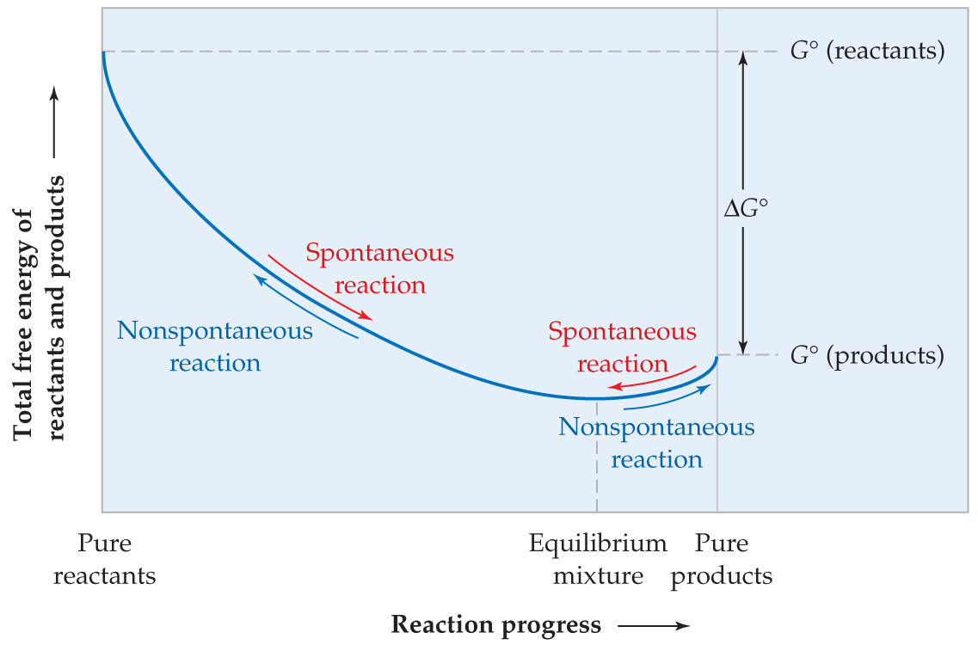
Thermodynamics of Equilibria
Pure reactants: the free energy decreases (∆G < 0) as the system moves toward equilibrium.
Pure products: the free energy also decreases (∆G < 0) as the system moves toward equilibrium.

Slide 57
Thermodynamics of Equilibria
What is ∆G°,
∆G?

Slide 58
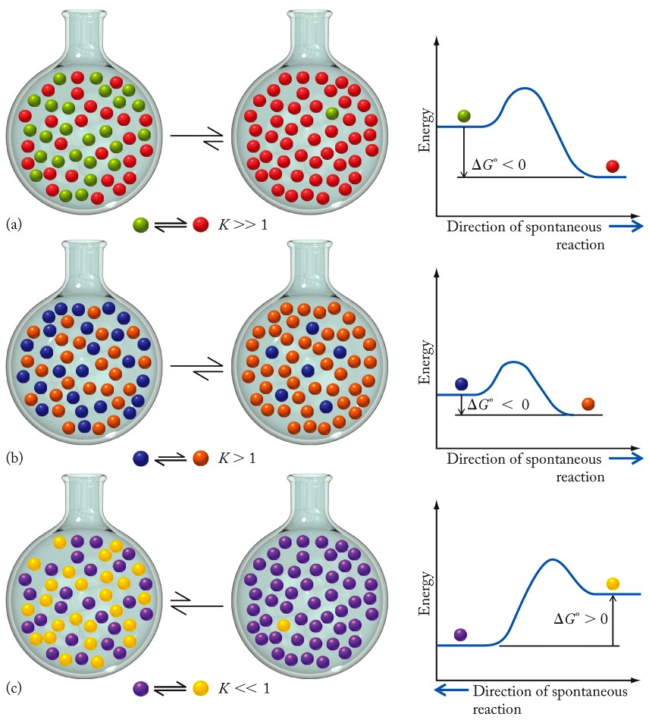
Thermodynamics of Equilibria
∆G° < 0; K is large, favors products.
Notes:
K has to be much larger than 1 in this case

Slide 59
Thermodynamics of Equilibria
∆G° slightly negative; K slightly favors products

Slide 60
Thermodynamics of Equilibria
∆G° > 0; K << 1, favors reactants.

Slide 61
Practice: Relationship Between K and ∆Gº
Using ∆G_{f}° values from Appendix 4, calculate the value of ΔGº and the equilibrium constant K at 298 K for:
2NO(g) + Cl₂(g) ⇌ 2NOCl(g)
Definitions of ∆G:
From Appendix 4:
Calculate ∆G°_{rxn}:
Calculate K:

Slide 62
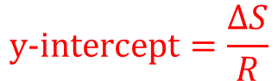
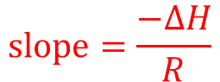
Equilibrium and Temperature
Gibbs Law of Free Energy
Relationship between ∆G and K
van ‘t Hoff equation
Substitute.
ln K vs. 1/T should be a linear plot
Where,
$$slope=\frac{−∆H}{R}$$
$$\text{y}\text{−}\text{intercept}=\frac{∆S}{R}$$

Slide 63
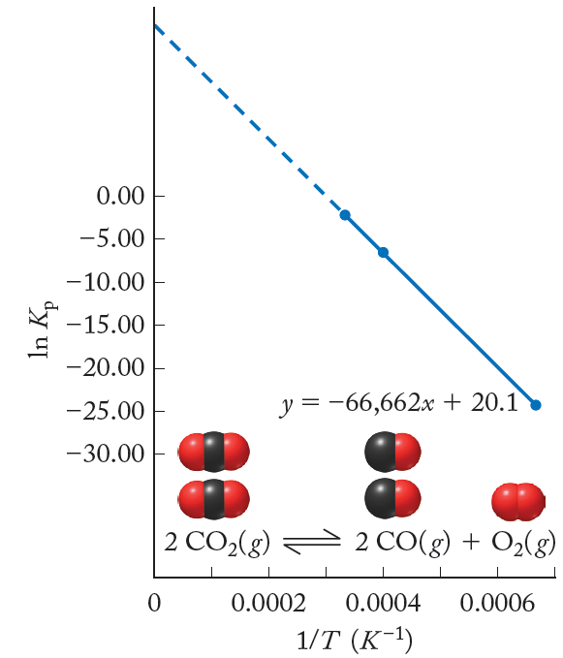
Equilibrium and Temperature
2CO₂(g) ⇌ 2CO(g) + O₂(g)
From equilibrium data, we are able to calculate thermodynamic data

Slide 64
Equilibrium and Temperature
For the same reaction, equilibrium constants can measured at different temperatures:
and
If we subtract the first equation from the second:
Assuming ∆S° is independent of T, K will vary with temperature as

Slide 65
Practice: K vs. Temperature
At 2000°C, the value of K_{c} for the reaction,
N₂(g) + O₂(g) ⇌ 2NO(g)
is 4.10×10⁻⁴. What is the value of K_{c} at 75°C if ΔH° = 180.6 kJ?
T₁ = 2000°C = 2273 K
T₂ = 75°C = 348 K
K₁ = 4.10 × 10⁻⁴
K₂ = ?
N₂(g) + O₂(g) + 180.6 kJ ⇌ 2NO(g)
lower the temperature, move toward the heat term
Results in shift of equilibrium to the left, smaller K_{c}

Slide 66
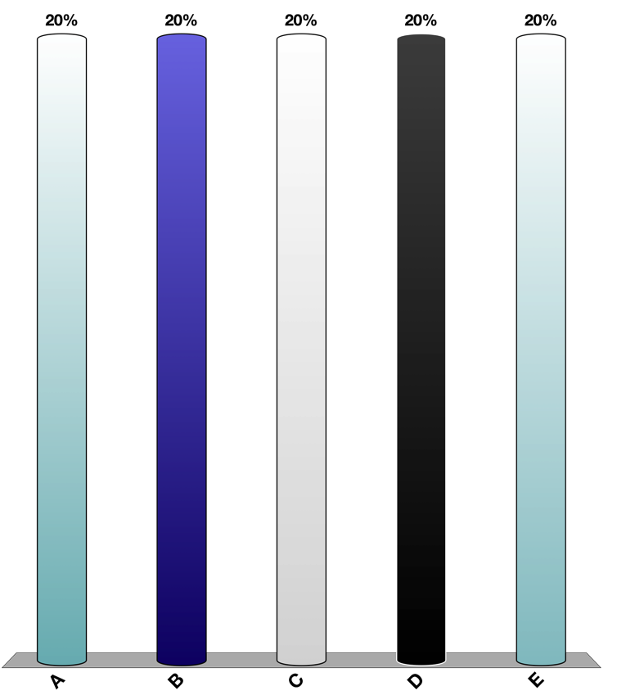
For the phase transition H₂O(l) ⇌ H₂O(g) at 298 K, ΔH° = 44.0 kJ/mol and ΔS° = 119 J/mol·K. What is the value of ∆G at 298 K when the partial pressure of water is 19.2 torr?
Practice: Thermodynamics/Equilibrium
Relationship for ∆G and partial pressures:
Calculate ∆Gº_{rxn}:
Plug-in vapor pressure and ∆Gº_{rxn}:
needs to be in atm, not torr
1 atm = 760 torr

Slide 67
Interplay of Kinetics/Thermodynamics
Generally speaking, for a chemical process, especially one done on the industrial scale. Two main characteristics are desired:
High product yield
Fast reaction rates
(At the cheapest possible price!!)
Ex. Haber process
N₂(g) + 3H₂(g) ⇌ 2NH₃(g)
+ 92.4 kJ
at 298 K, K_{p} = 6.1×10⁵
favorable for reasonable amount of product formation
But, we can make it go faster if we raise temperatures!?!?
at 773 K, K_{p} = 7.3×10⁻⁵
very little product formation will occur due to place of the equilibrium
Why is this?
How do we overcome this problem?

Slide 68
Interplay of Kinetics/Thermodynamics
Why is this?
N₂(g) + 3H₂(g) ⇌ 2NH₃(g) + 92.4 kJ
at 298 K, K_{p} = 6.1×10⁵
at 773 K, K_{p} = 7.3×10⁻⁵
Let’s take a closer look at the energetics:
at equilibrium ∆G = 0
for reaction to be spontaneous:
∆G < 0
Notice:
, T < 467 K
at 298 K, ∆G < 0, spontaneous forward reaction
at 773 K, ∆G > 0, nonspontaneous forward reaction

Slide 69
Interplay of Kinetics/Thermodynamics
Based on our discussions of equilibrium,
∆G < 0, spontaneous forward reaction, means mostly products found at equilibrium.
∆G > 0, nonspontaneous forward reaction, means some (but very little) products found at equilibrium.
This is a more complete view of thermodynamics. All reactions have an equilibrium (reverse reaction) to an extent.

Slide 70
Interplay of Kinetics/Thermodynamics
Desired characteristics are:
High product yield
Fast reaction rates
(At the cheapest possible price!!)
N₂(g) + 3H₂(g) ⇌ 2NH₃(g) + 92.4 kJ
at 298 K, K_{p} = 6.1×10⁵
at 773 K, K_{p} = 7.3×10⁻⁵
By raising temperatures, we have increased the rate.
At high temperature product yield is poor. How do we overcome this problem?
Le Châtelier’s Principle
constantly “remove” NH₃ as it is formed, thus driving the reaction forward

Slide 71
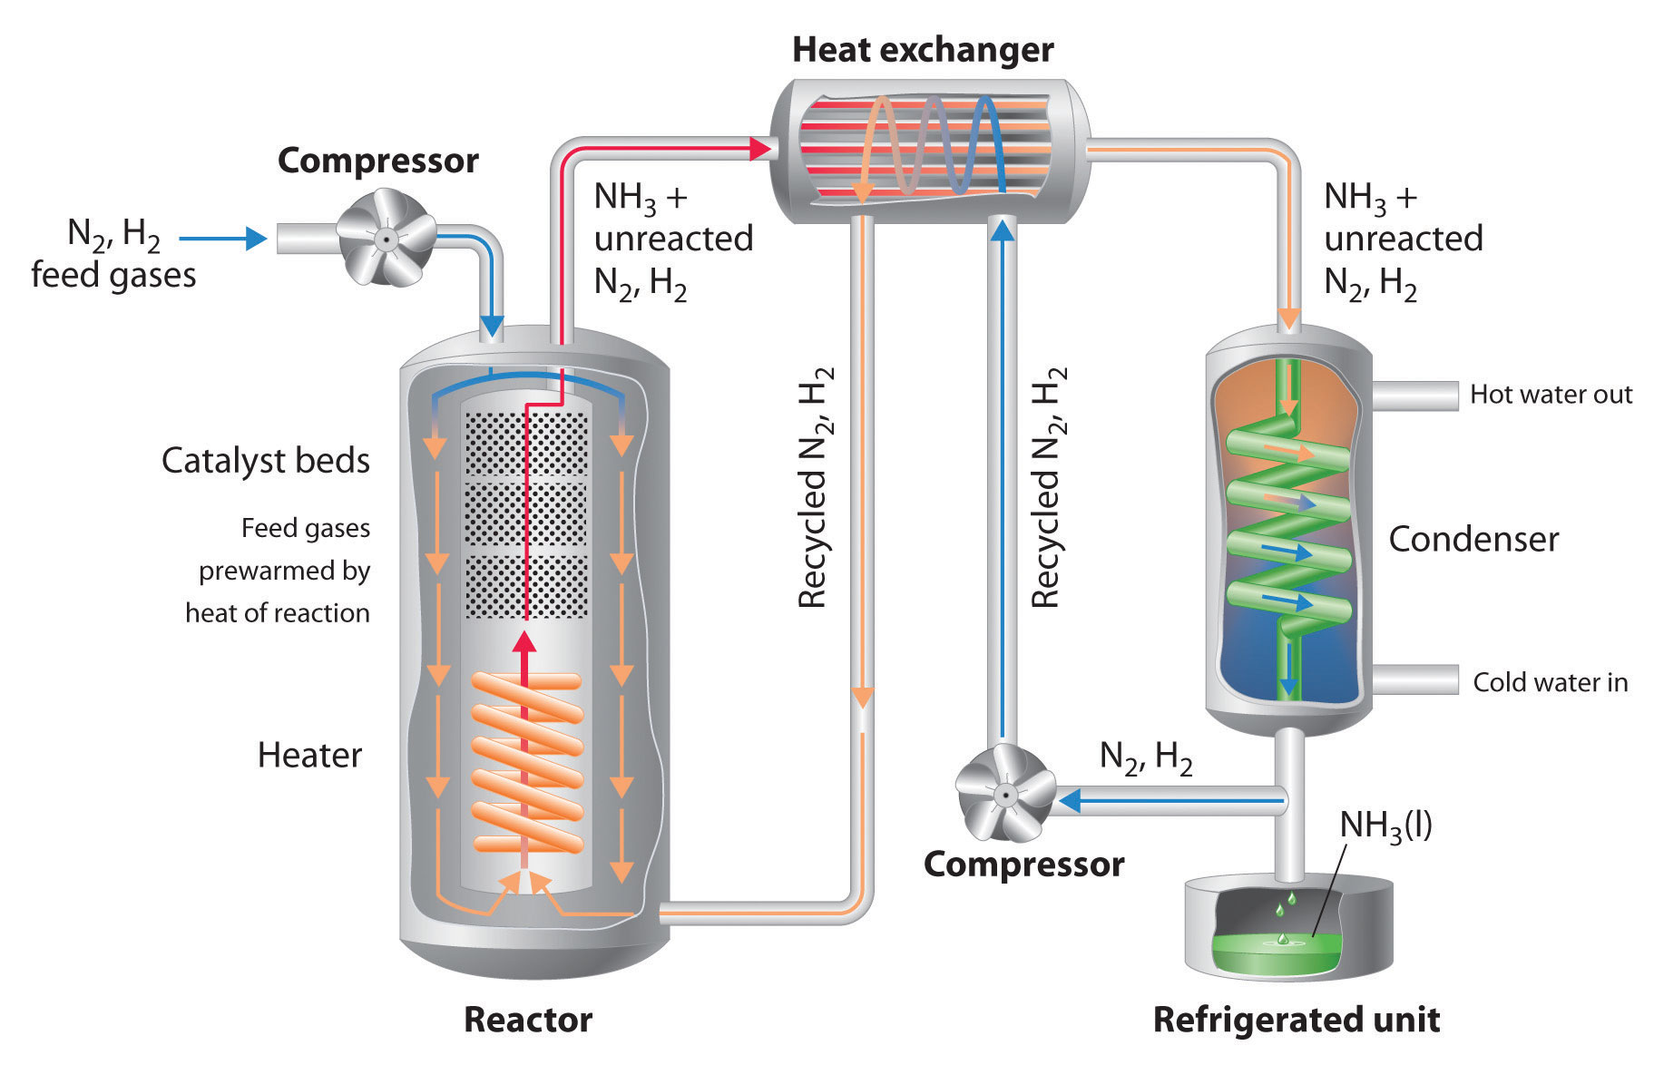
Interplay of Kinetics/Thermodynamics
Haber process
ammonia condensed out of the equilibrium as a liquid!
Image: http://newsletter.flatworldknowledge.com/bookhub/reader/4309?e=averill_1.0-ch15_s06

